Slide 1

TEAM 1 - Project Phase 2
Group Members
Raviraj Ahire
Amita Akole
Mohammed Zeeshan Ali
Pooja Deepak Bhamare
Shivangi Jagdishkumar Bhavsar
IS 664 - DATABASE PROGRAMMING

Slide 2
LOADING THE DATA INTO THE DATABASE
Amita , Pooja
To populate the data from provided data set , 25000 records were imported in chronological manner with help of import data wizard feature of my work bench .
The provided data set is accommodate in three distinguish tables ,
client _infomration , client_occupation and lining table , Client_ return .
To execute the query statements provided in phase 2 , different stored procedures has been used .
IS 664 - DATABASE PROGRAMMING

Slide 3
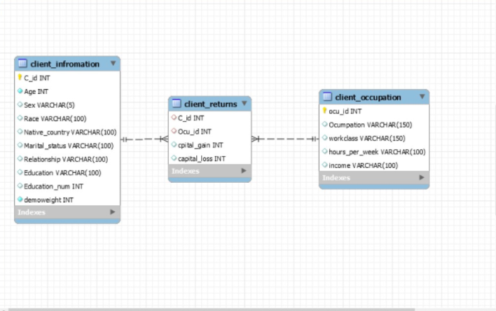
UPDATED ER DIAGRAM
Raviraj , Shivangi , Zeeshan
IS 664 - DATABASE PROGRAMMING

Slide 4
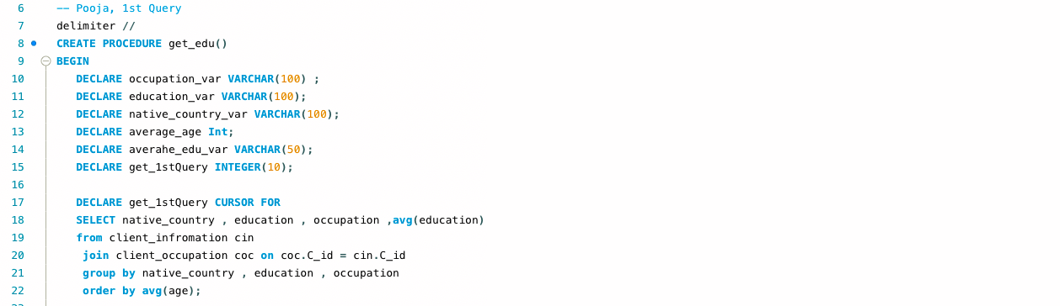
Q1
Pooja
QUERY 1
IS 664 - DATABASE PROGRAMMING

Slide 5
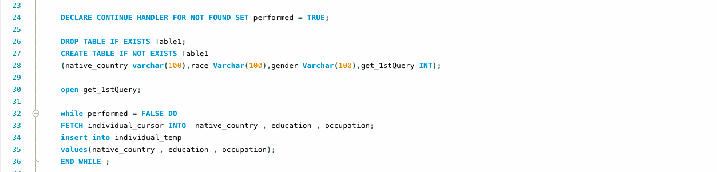
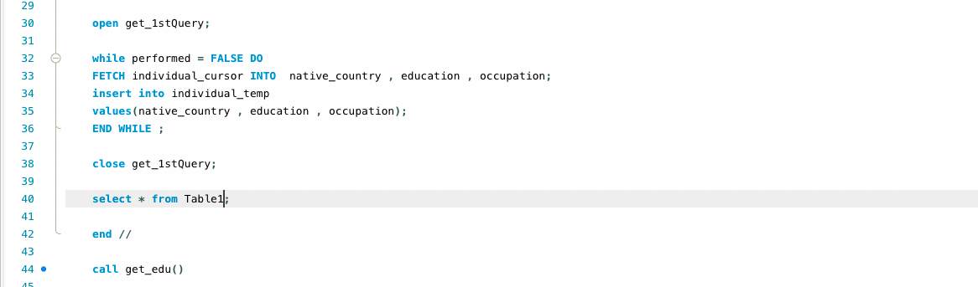
QUERY 1
Pooja

Slide 6
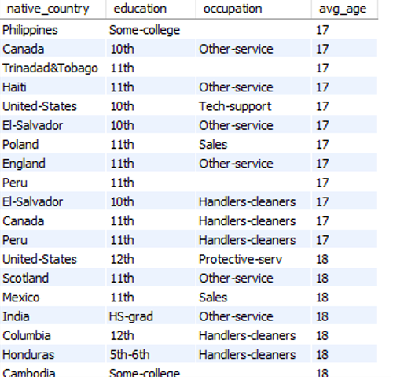
QUERY 1
Pooja

Slide 7
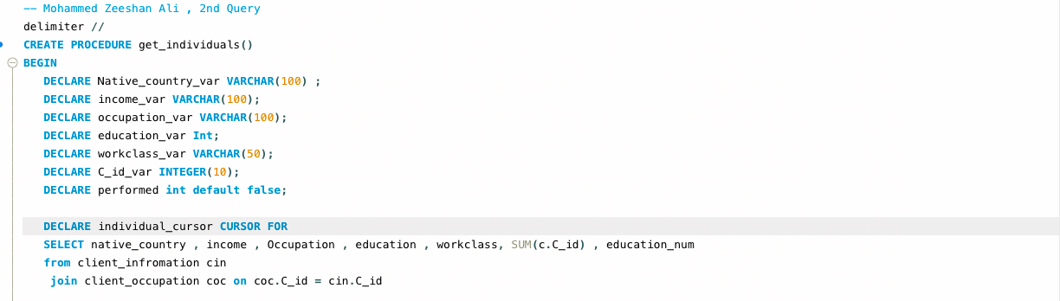
Q2
QUERY 2
Mohammed Zeeshan Ali
IS 664 - DATABASE PROGRAMMING

Slide 8
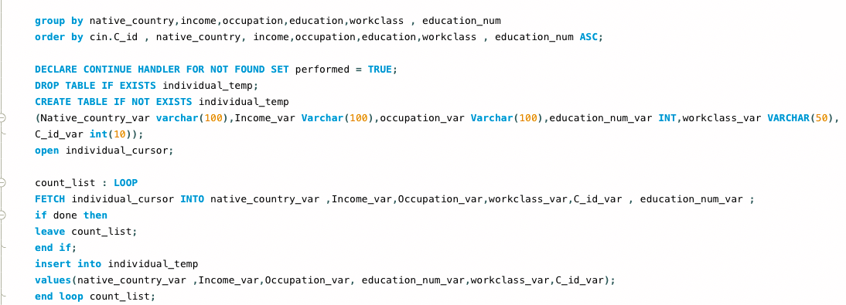
Q2
QUERY 2
Mohammed Zeeshan Ali
IS 664 - DATABASE PROGRAMMING

Slide 9
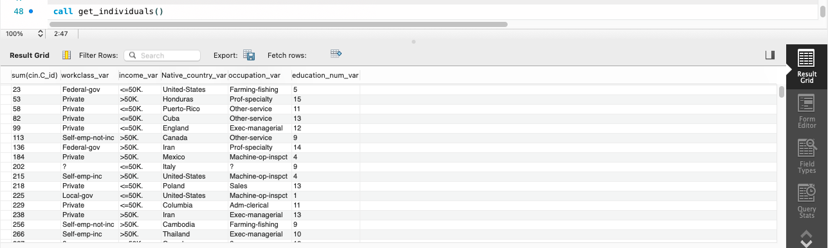
Mohammed Zeeshan Ali
QUERY 2
IS 664 - DATABASE PROGRAMMING

Slide 10
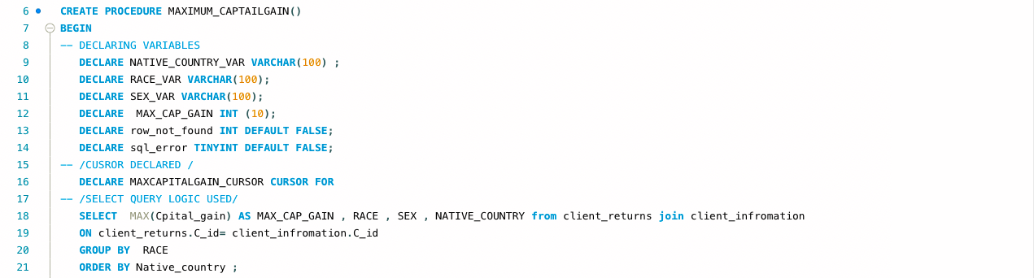
QUERY 3
Shivangi bhavsar

Slide 11
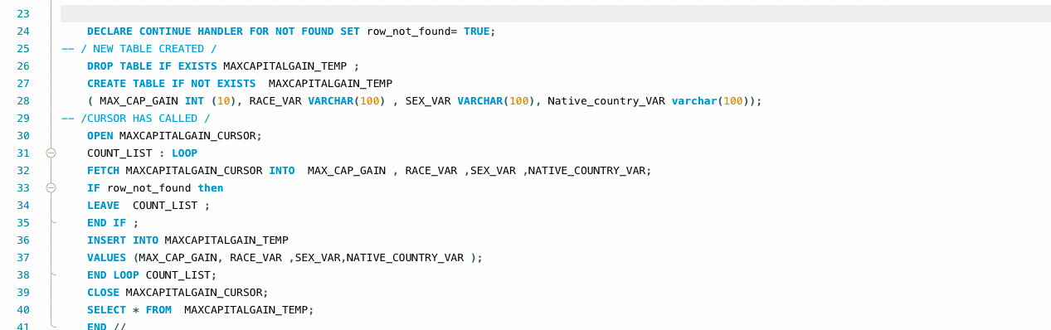
QUERY 3
Shivangi bhavsar

Slide 12
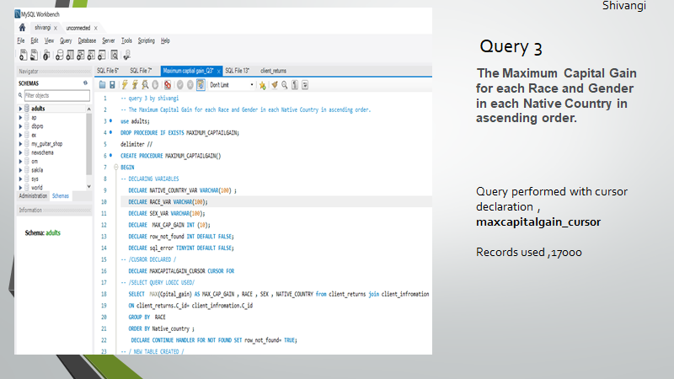
Q3
QUERY 3
i
Shivangi bhavsar

Slide 13
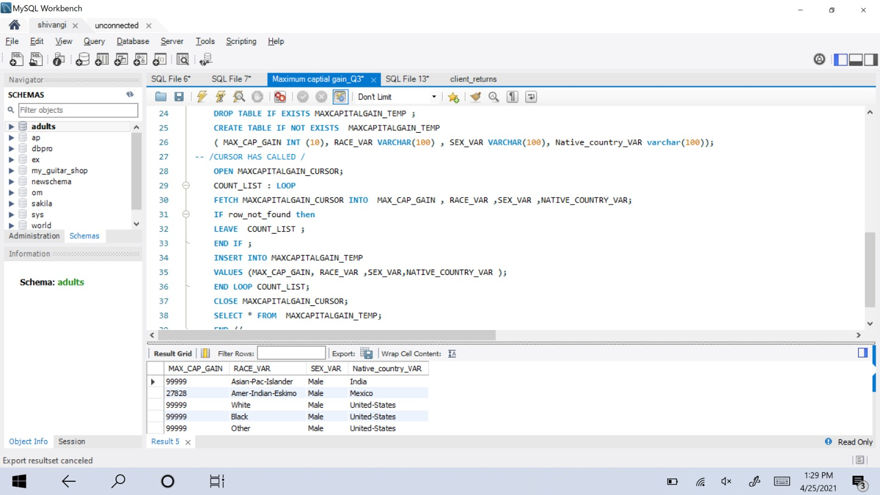
Q3
QUERY 3
i
Shivangi bhavsar

Slide 14
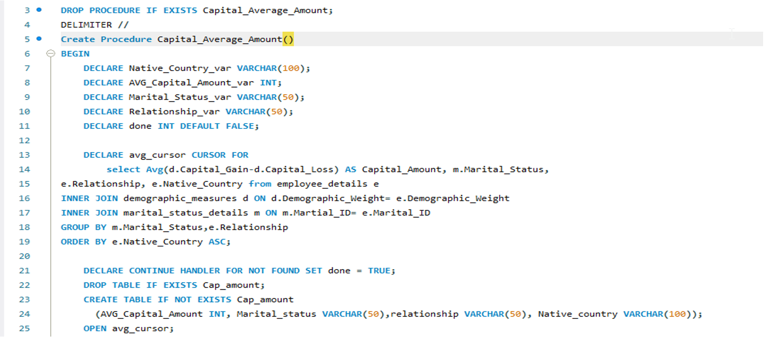
Q4
QUERY 4
Amita

Slide 15
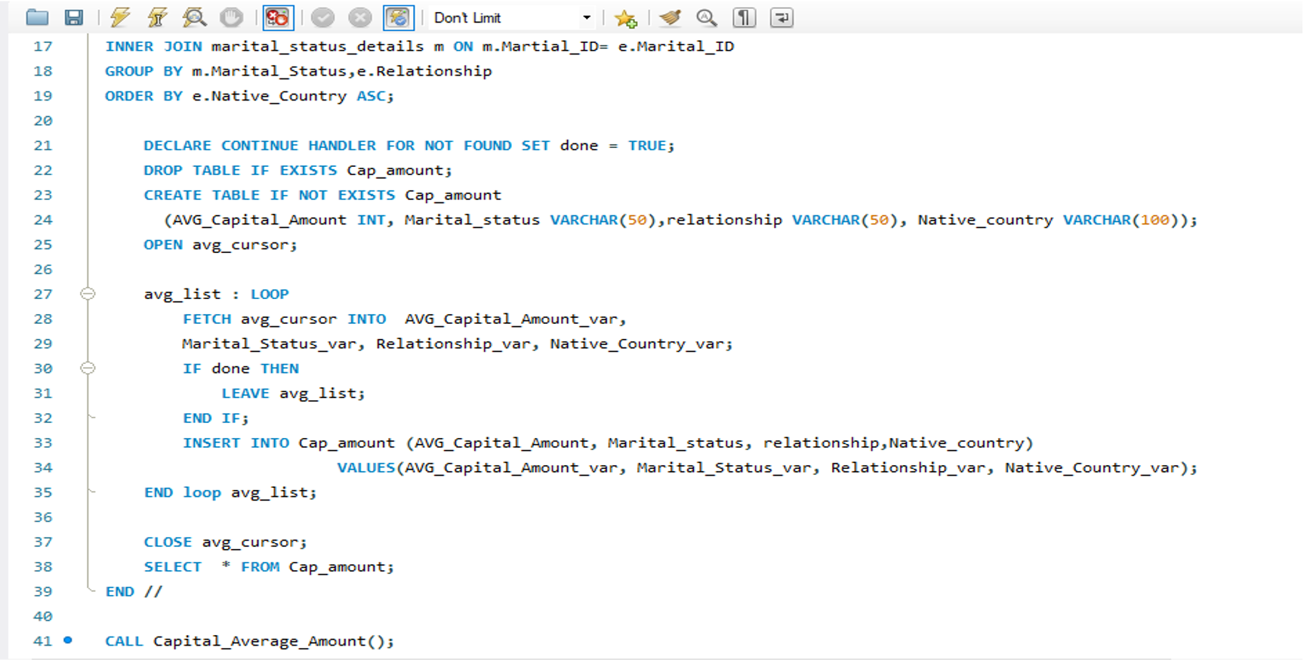
QUERY 4
Amita

Slide 16
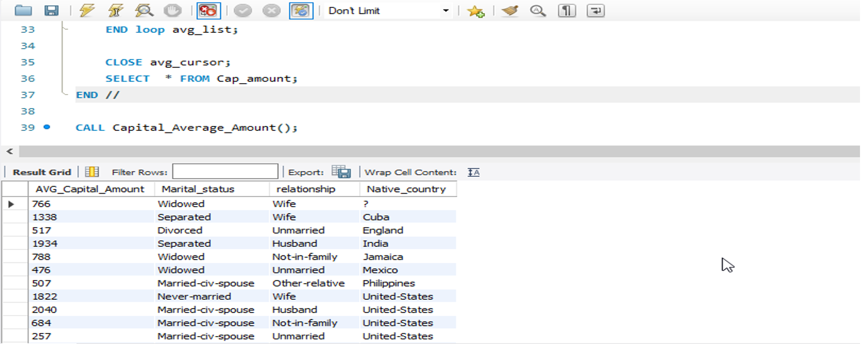
QUERY 4
Amita

Slide 17
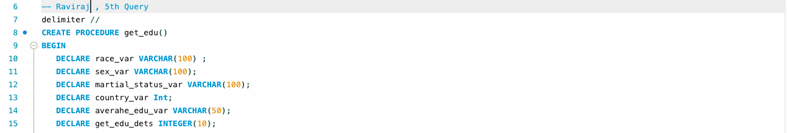
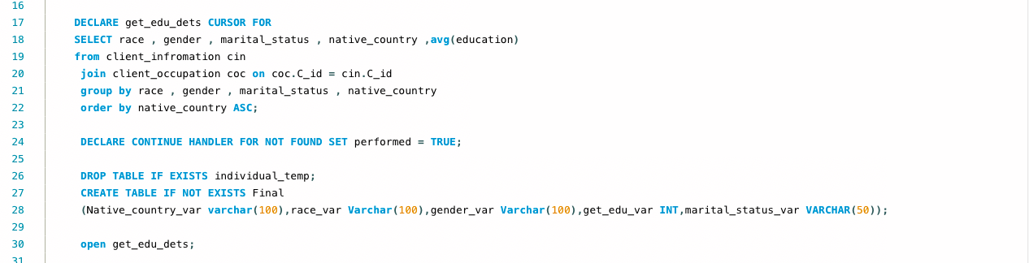
QUERY 5
Raviraj Ahire

Slide 18
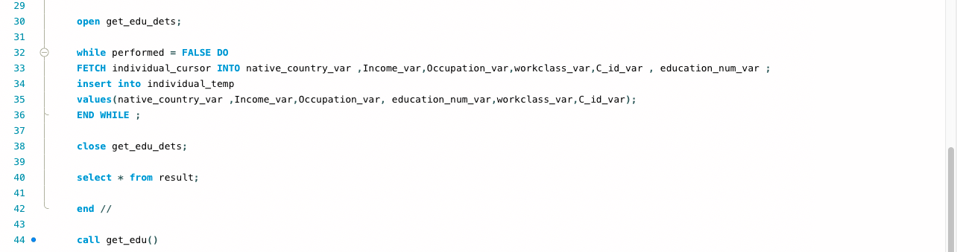
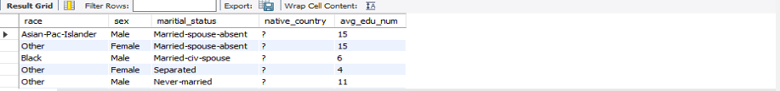
QUERY 5
Raviraj Ahire

Slide 19
SUMMARY
Raviraj , Zeeshan
An updated ER Diagram shows proof that database has achieved 3NF
All the queries have been executed based on the database created for the phase
Stored procedures and Cursors have been used to execute the queries
All the records were loaded into the database (25,000) using table import wizard in accordance with the database.
IS 664 - DATABASE PROGRAMMING

Slide 20
THANK YOU!!!!!
IS 664 - DATABASE PROGRAMMING

